Slide 1



SmartStock Inventory Optimization for Retail Stores
Intelligent Store Sales Forecasting & Inventory Management System
GET STARTED
Presented by:
Group -2
Guided by:
shakthi Gopalakrishnan

Slide 2


Meet Our Team
VAISHNAVI
DURGA PRASAD
SMRITI
AMAN KUMAR
GIRIJA PAVANI

Slide 3


Table Of Content
01.
02.
03.
04.
05.
Introduction & Objective
Problem Statement
Proposed Solution
Technology Stack
System Architecture
06.
07.
08.09.
10.
ML Model & Forecasting Logic
Key Features & Modules
Database Design
Live Demo / UI Walkthrough
Future Scope & Conclusion

Slide 4


Problem Statement
STOCKOUTS
Losing sales because items are out of stock.
LACK OF AGILITY
01.
04.
Traditional systems cannot react quickly to promotional changes.
OVERSTOCKING
MANUAL ERRORS
Wasting capital and storage space on items that won't sell.
Human error in predicting demand leads to inefficiencies.
02.
03.

Slide 5

The Solution
A full-stack web application that predicts future sales using Machine Learning.
Automatically compares predictions with current stock levels.
Classifies inventory status: Overstock, Understock, or Balanced.
Sends real-time alerts via Email and SMS to store managers.

Slide 6



Key Features
📊 Interactive Dashboard: Visualizes sales trends and inventory health using Chart.js.
🤖 AI Forecasting: Uses Historical Gradient Boosting to predict demand.
🔔 Automated Alerts: Configurable notifications (SMS/Email) for critical stock levels.
🔒 Secure Authentication: JWT-based Login, Registration, and Password Reset.
📦 Inventory Management: CRUD operations to add, update, or delete store items.
🌗 UI Personalization: Dark/Light mode toggle for user preference.
TARGET ACHIEVED

Slide 7

Technology Stack
Frontend: HTML5, CSS3, JavaScript (Vanilla), Chart.js (Visualization).
Backend: Python, FastAPI (High-performance API).
Machine Learning: Scikit-Learn (HistGradientBoostingRegressor), Pandas, NumPy.
Database: MySQL (Relational Data), SQLAlchemy (ORM).
Integrations: Twilio (SMS), SMTP (Email).
Authentication: JWT (JSON Web Tokens), Passlib (Hashing).

Slide 8

System Architecture
Data Ingestion: Loads dataset from Hugging Face (Rodrigo2204/store-sales-forecast).
Training: The ML Pipeline processes data and trains the model.
API Layer: FastAPI exposes endpoints for predictions and inventory.
Client Layer: The Browser fetches data and renders graphs.
Notification Service: Background tasks trigger SMS/Email alerts.

Slide 9

Machine Learning Model
The Brain Behind SmartStock
Algorithm: HistGradientBoostingRegressor (Optimized for large datasets).
Feature Engineering:
Extracts Year, Month, Day, and Day of Week.
Uses OneHotEncoder for Categorical data (Store ID, Family).
Training Workflow:
Splits data (Train/Test).
Pipeline: Preprocessing Model Fitting.
Metrics: Tracks MAE (Mean Absolute Error), RMSE, and R^2 Score.

Slide 10
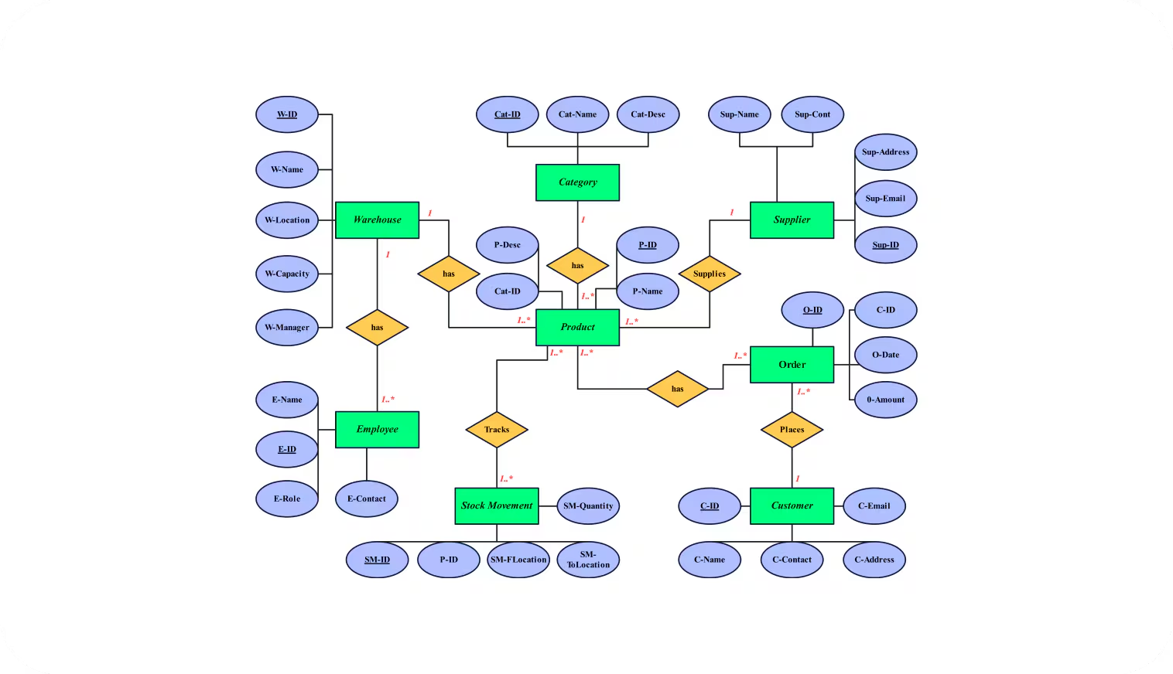
Database Schema
Data Modeling (MySQL)
Users: ID, Name, Email, Password Hash (Secure).
Inventory: Store Number, Item Family, Current Stock.
SalesRecords: Historical sales data used for training.

Slide 11
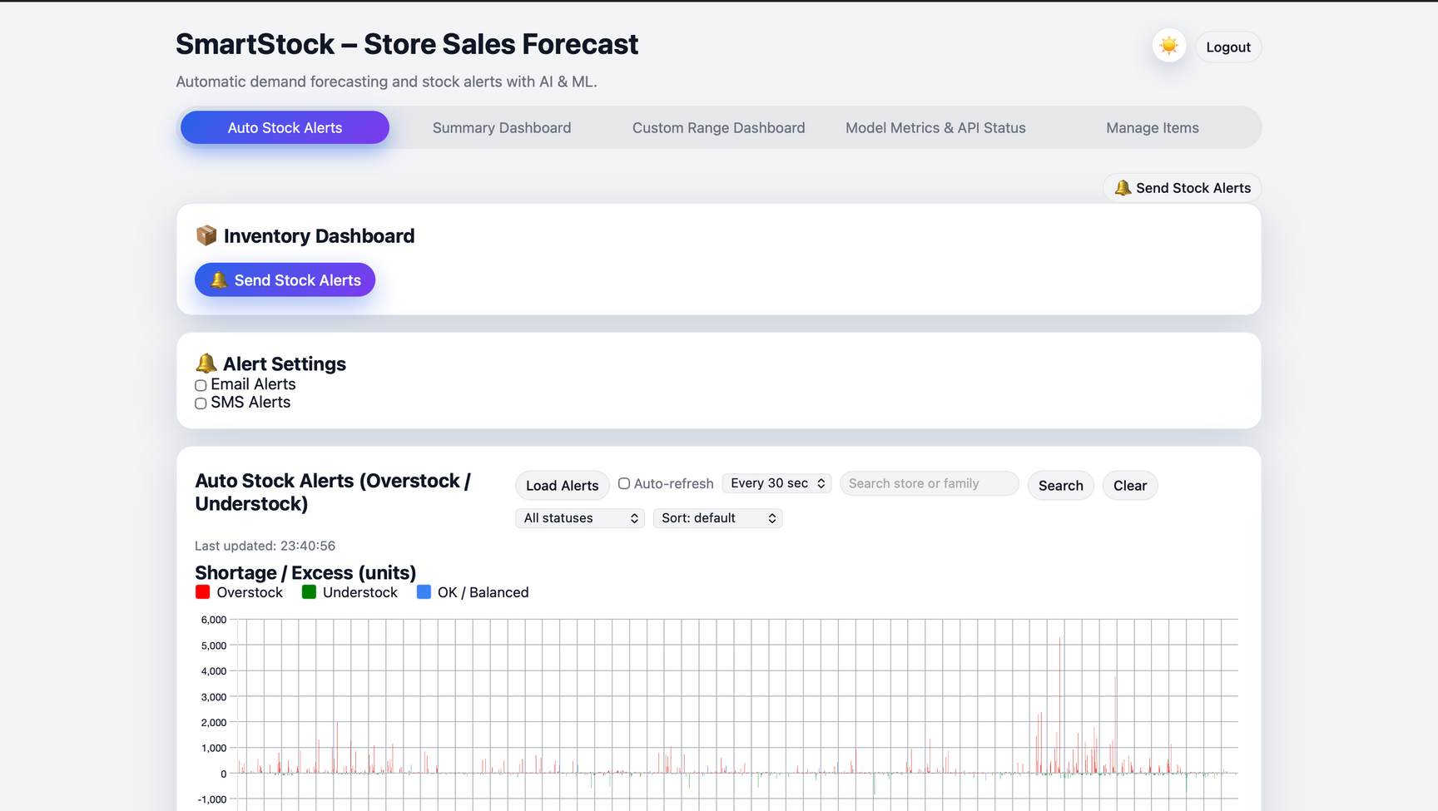
User Workflow
How It Works
Login: User authenticates via secure login page.
Dashboard: User views "Auto Stock Alerts" graph to see red (Overstock) or green (Understock) bars.
Analysis: User checks specific "Critical Alerts" table.
Action: User triggers "Send Alerts" to notify the procurement team.
Management: User adds new items via the "Manage Items" tab.

Slide 12


Notification System
Logic:
If Stock < 0.8 * Predicted Demand Understock Alert.
If Stock > 1.2 * Predicted Demand Overstock Alert.
Channels:
Email: Uses SMTP (Gmail) to send detailed reports.
SMS: Uses Twilio API for instant urgent notifications.
Settings: Toggle switches in UI to enable/disable specific channels.

Slide 13

Future Enhancements
Advanced Models: Implement LSTM or Prophet for time-series deep learning.
Supplier Integration: Automatically generate Purchase Orders (POs) sent to suppliers.
Multi-User Roles: Admin vs. Store Manager permissions.
Dockerization: Containerizing the app for cloud deployment (AWS/Azure).

Slide 14

SmartStock bridges the gap between raw data and actionable insights.
It reduces waste and prevents revenue loss.
A modern, scalable solution built with Python and FastAPI.

Slide 15


